Slide 1
Computer Components
By: Michael Chillemi

Slide 2
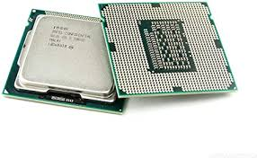
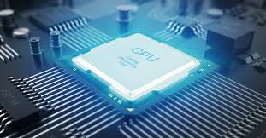
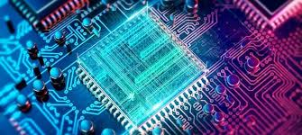
CPU
CPU stands for Central Processing Unit.
It is mainly composed of the control unit, main memory and arithmetic-logic unit.
People would usually say the CPU is the heart of the computer system.
The CPU is linked to input and output devices.
In most computers nowadays the cpu is contained on an integrated circuit chip called a microprocessor.

Slide 3
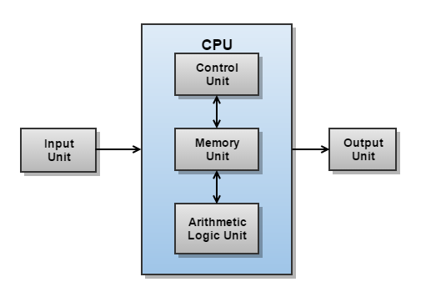
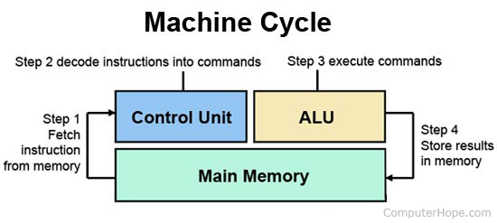
Control Unit
The control unit is a very important part of the cpu.
The control unit regulates and integrates the operation of the computer.
This unit also selects and retrieves instructions from the main memory in proper sequence and interprets them.
This unit is very important to making the whole computer work fluently
It works with the logic unit, memory unit , input and output devices.

Slide 4
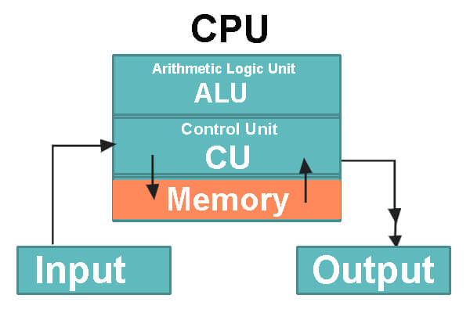
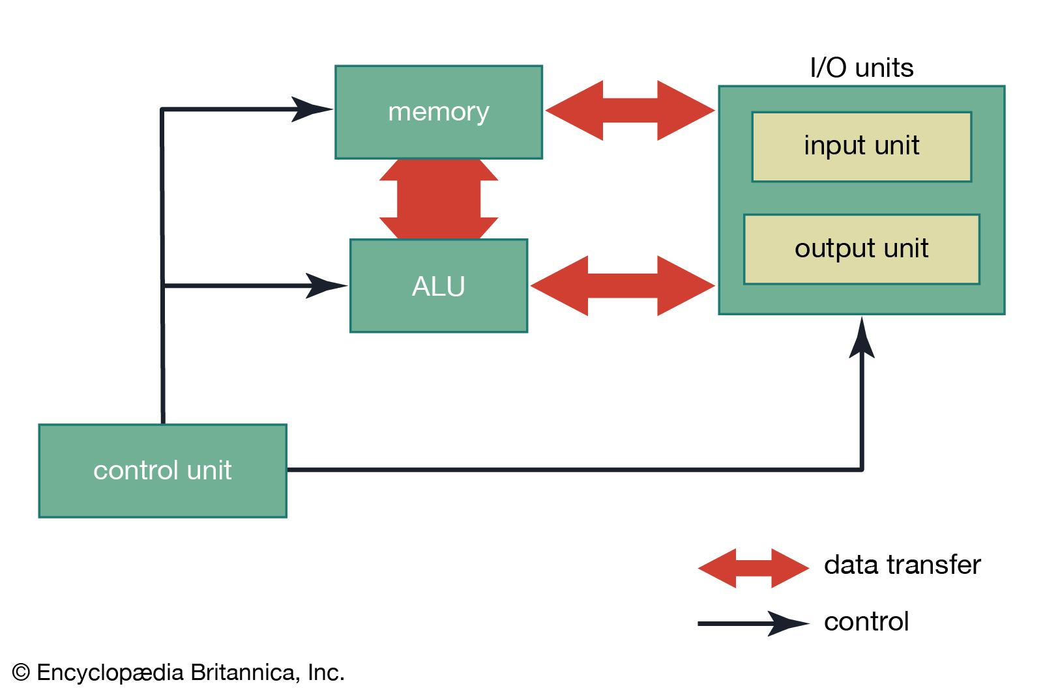
Arithmetic Unit & Logical Unit (ALU)
This is a digital circuit used to perform arithmetic and logical operations.
It performs operations such as addition, subtraction, multiplication, division and logical operations such as AND & OR.
This is a basic building block of a CPU

Slide 5
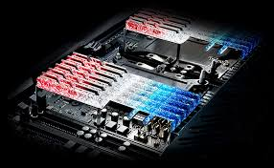
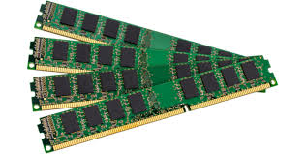
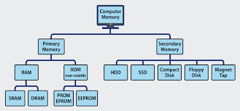
Memory
Two types of memory Primary and Secondary memory
There is two types of Primary memory RAM and ROM
RAM stands for “Random Access Storage”
ROM Stands for “Read Only Memory”
RAM is a really fast and temporary data storage space for the computer to access right at that moment or in a few moments
Memory can also be a physical device you connect or build in your computer
This type of memory can be used to store anything you want on it as long as you save it.

Slide 6
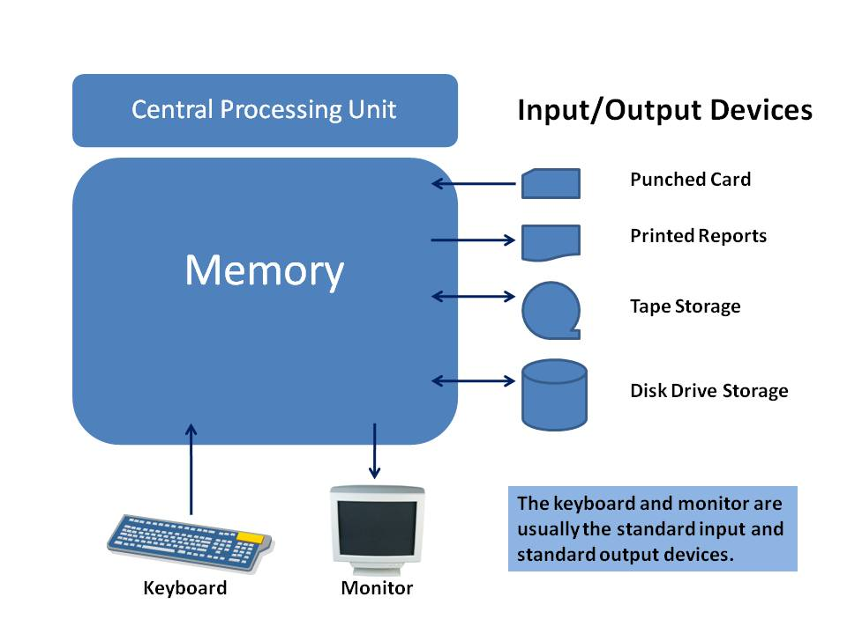
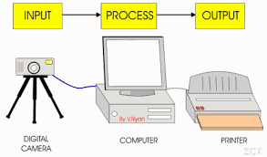
Input and Output
Input is the data that is received by the computer
Output is the data that the computer sends
An input device is something you connect to a computer that sends information into the computer
As an example let's say your in java and you create your first Hello World program you want to see if the program will run so you save and run the program. Right when you hit the run button your computer the computer process and digitizes that into input information the results of this process is sent to the console which is an output device to read your program “Hello World”.

Slide 7
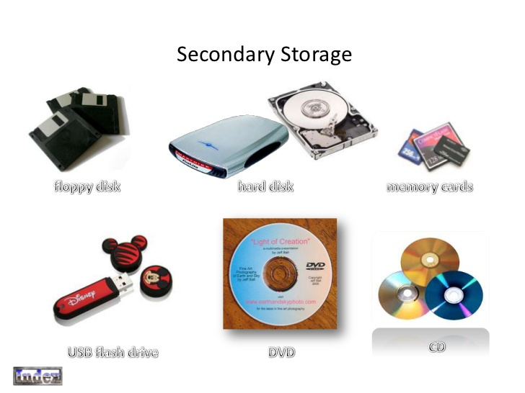
Auxiliary Memory
Auxiliary memory are units such as input and output devices that are storage devices .
The difference between these storage devices and RAM & ROM is they move at a slower acces rate but has greater data storage and data stability.
These types of storage devices hold information for use in the future and are nonvolatile like ROM
They are made to hold data and programs that are not intended of being used immediately

Slide 8
Sources
https://www.britannica.com/technology/central-processing-unit
https://www.avast.com/c-what-is-ram-memory#:~:text=RAM%20is%20your%20computer's%20short%2Dterm%20memory.&text=Every%20computing%20device%20has%20RAM,longer%2Dterm%20access%2C%20too.
https://www.computerhope.com/jargon/m/memory.htm
https://www.bbc.co.uk/bitesize/topics/zf2f9j6/articles/zx8hpv4#:~:text=An%20input%20is%20data%20that,sound%20from%20a%20computer's%20speakers.
https://www.britannica.com/technology/computer-memory/Auxiliary-memory
https://www.javatpoint.com/coa-auxiliary-memory
https://www.britannica.com/technology/control-unit
https://www.computerhope.com/jargon/c/contunit.htm
https://www.britannica.com/technology/arithmetic-logic-unit
https://whatis.techtarget.com/definition/arithmetic-logic-unit-ALU

